Slide 1

Exploratory Data Analysis
G2m Insight for Cab Investment Firm
Alexis Collier
8 AUG 2023

Slide 2

Agenda
Executive Summary
Problem Statement
Approach
Exploratory Data Analysis (EDA)
Hypothesis Testing
Recommendations
Conclusions

Slide 3
Problem Statement
XYZ is a private equity firm in the US. Due to remarkable growth in the cab industry in the last few years and multiple key players in the market, XYZ is planning for an investment in the cab industry.
With actionable insights to help XYZ identify the right company for investing, this analysis will include:
Data Understanding
Data Visualization
Creating multiple hypotheses
Building models and finding the best fit model

Slide 4
Data Information
Cab_Data.csv – this file includes details of transactions for two cab companies
Customer_ID.csv – this is a mapping table that contains a unique identifier that links the customer’s demographic details
Transaction_ID.csv – this is a mapping table that contains transaction-to-customer mapping and payment mode
City.csv – this file contains a list of US cities, their population, and the number of cab users
* Timeframe of the data: 2016-01-31 to 2018-12-31

Slide 5

EXPLORATORY DATA ANALYSIS

Slide 6
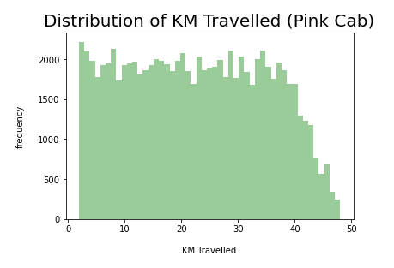
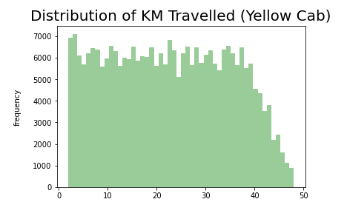
Distribution of KM Travelled for both Cabs:
Both the pink and yellow cabs, most cabs travelled between 2 to 48 KM

Slide 7
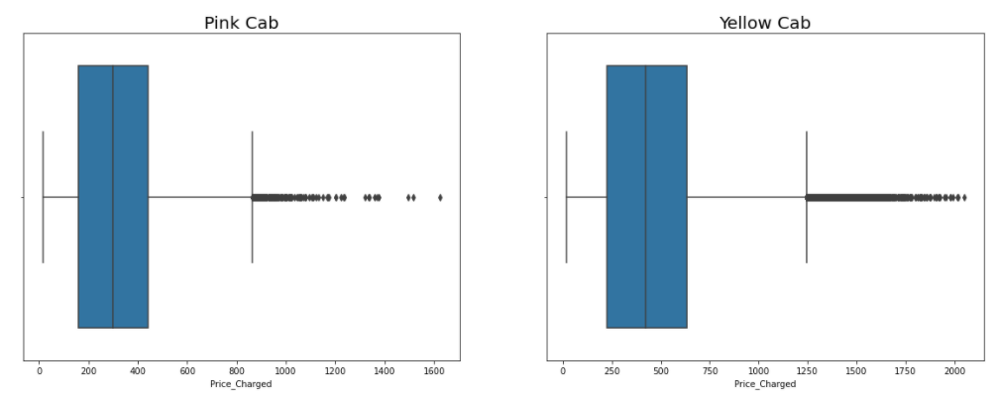
Distribution of Price Charged for both Cabs:
The price charge range for a yellow cab is more than a pink cab. The outliers are the use of high-end cars.

Slide 8
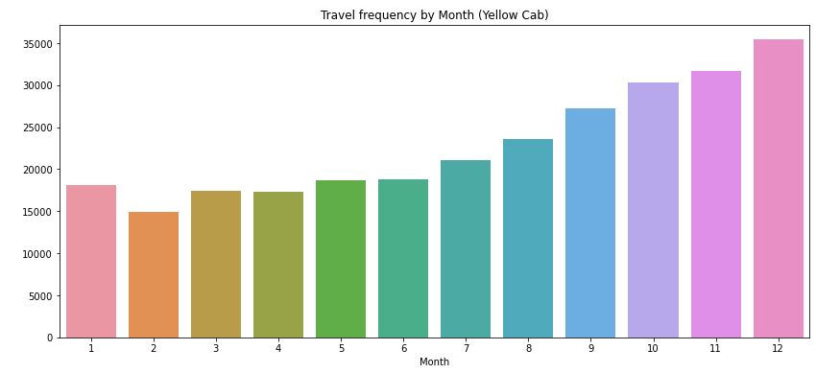
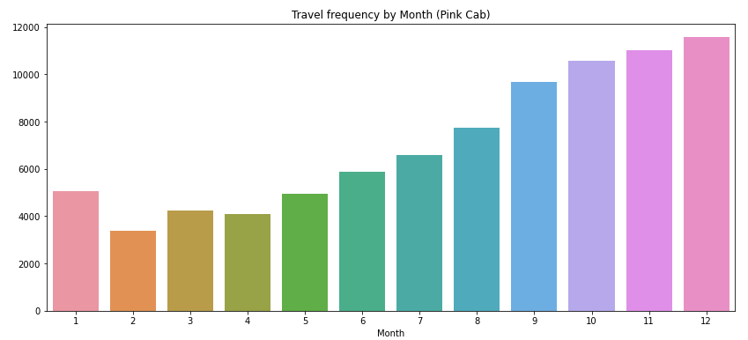
Travel Frequency per Month:
The yellow cab had the highest travel frequency in December during the holiday season compared to the pink cab

Slide 9
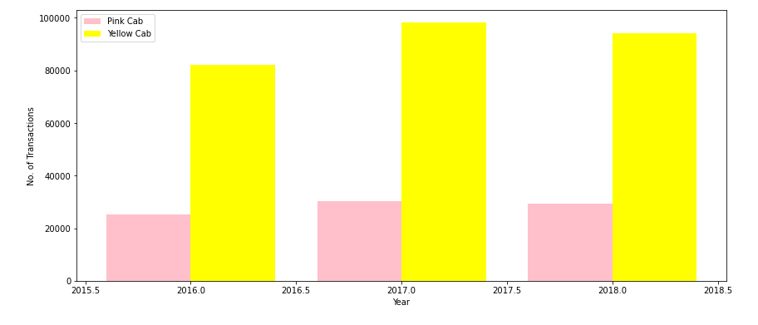
Transaction per Year for both Cabs:
The number of transactions for the yellow cabs was higher than for the pink cabs for each year

Slide 10
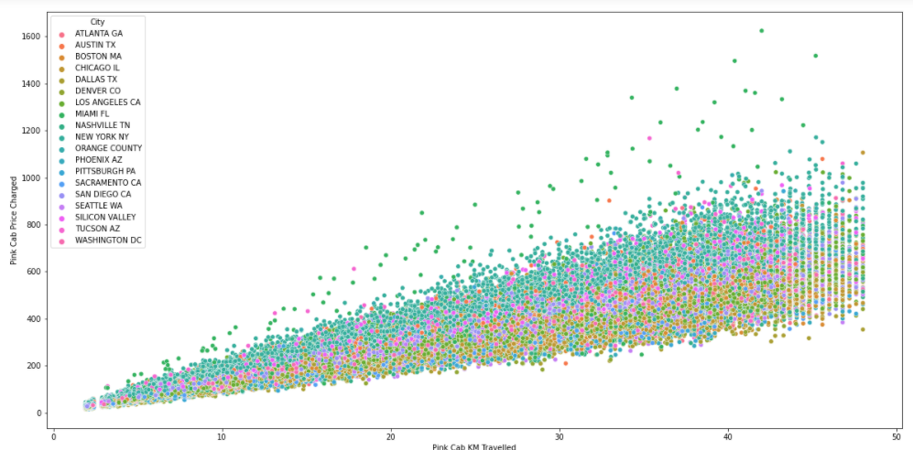
Pink Cab - Price Charged per KM per City:
There was a correlation between the cities having the same increase in price and the same increase in distance

Slide 11
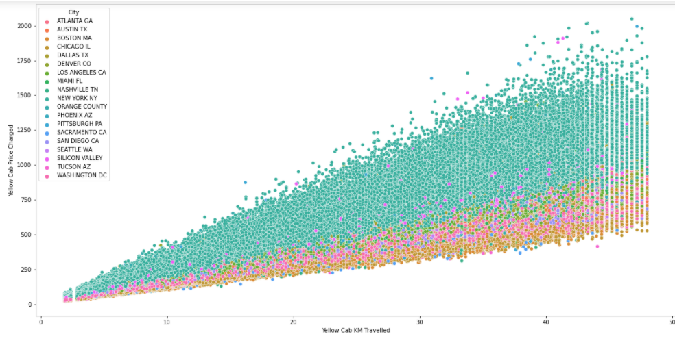
Yellow Cab - Price Charged per KM per City:
In New York City, the price charged the most compared to all the other cities for the yellow cab

Slide 12
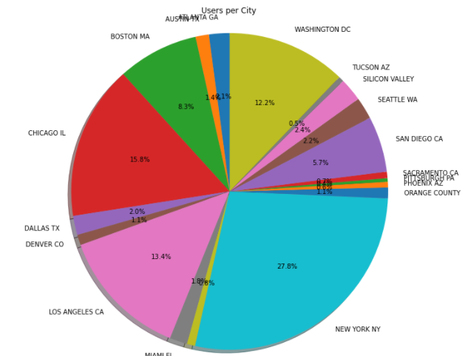
Cab Users per City:
New York City has the most cab users with 28%, followed by Chicago with 16% and Los Angeles with 13%

Slide 13
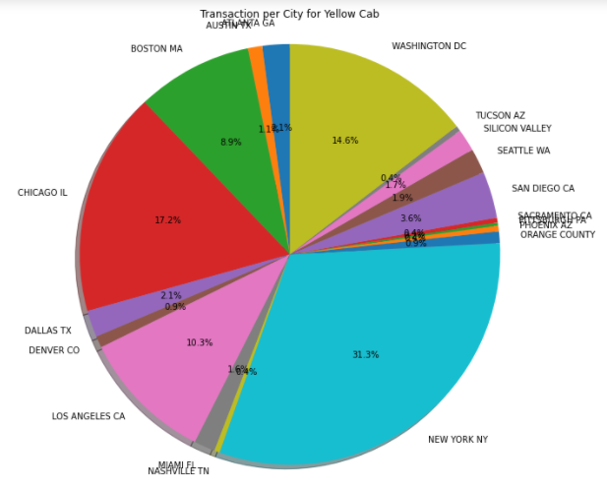
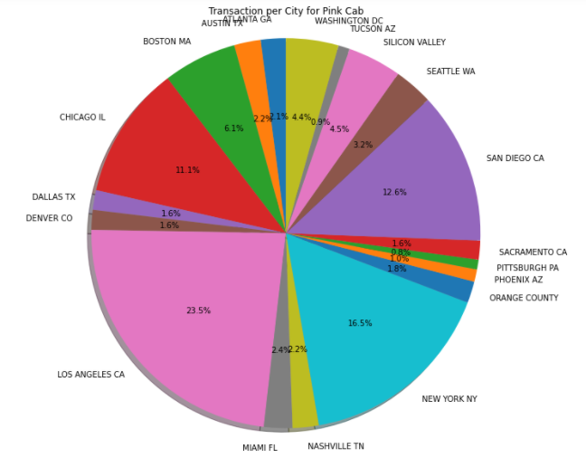
Transaction per City for both Cabs:
Transactions for the yellow cab are highest in New York City at 31%, and for the pink cab, the highest number of transactions is in Los Angeles City at 23.5%

Slide 14
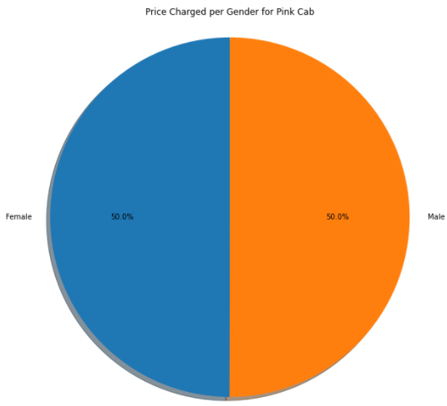
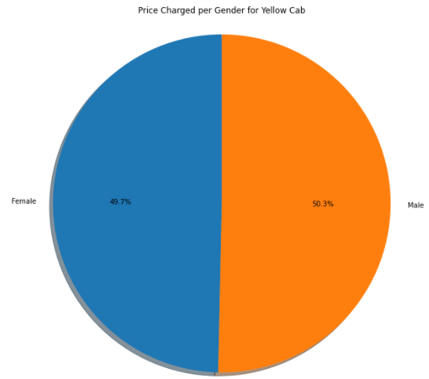
Price Charged per Gender for both Cabs:
Yellow cabs charged less for female customers compared to the pink cab setting the same price for male and female customers

Slide 15
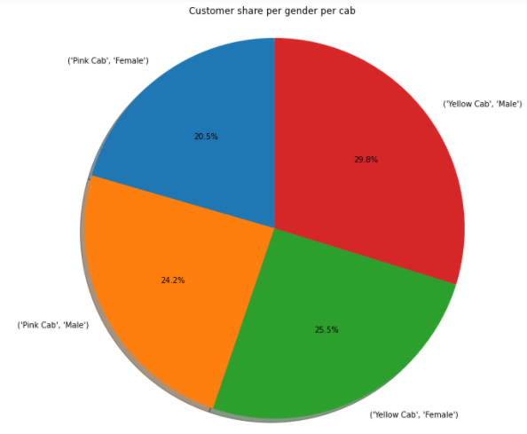
Customer Share Per Gender for Both Cabs:
Based on per gender for both cabs, the female gender percentages are 25.5% for the yellow cab compared to 20.5% for the pink cab

Slide 16
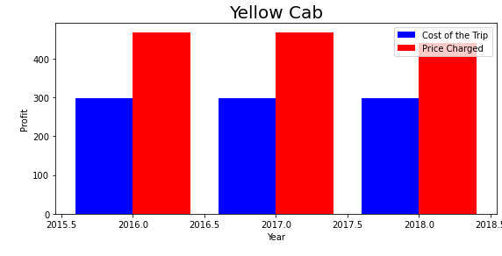
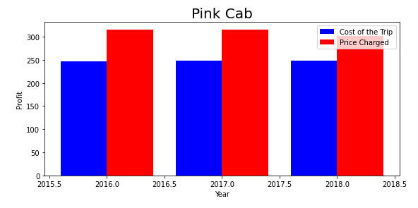
Profit Margin Per Year for Both Cabs:
The yellow cab has a higher profit margin than the pink cab

Slide 17
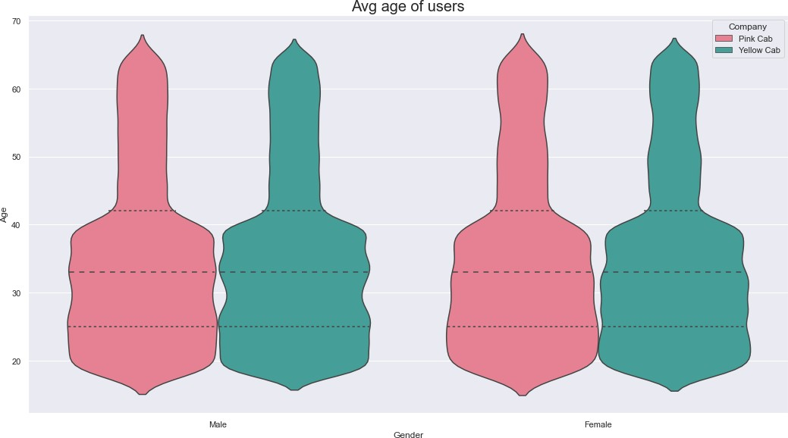
Average Age of Users
35 is the average age of cab users for both genders

Slide 18
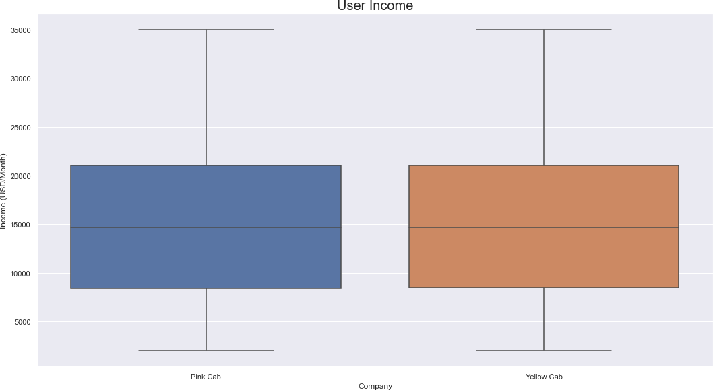
Average Income of Users
The average income is around $15,000 for cab users

Slide 19
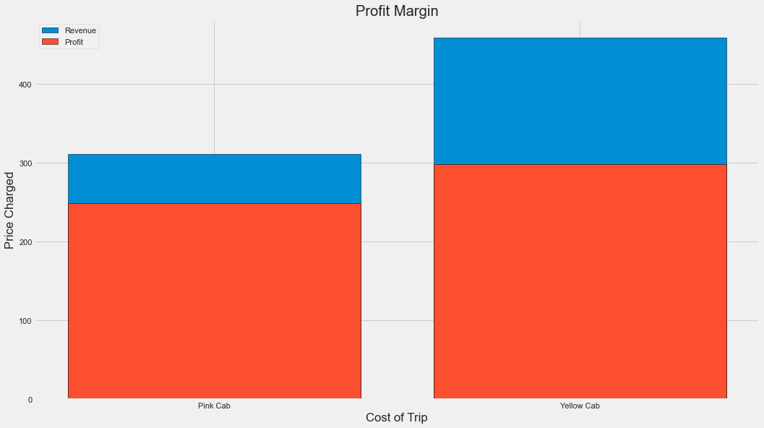
Profit Margin
The yellow cab has a higher profit margin compared to the pink cab

Slide 20
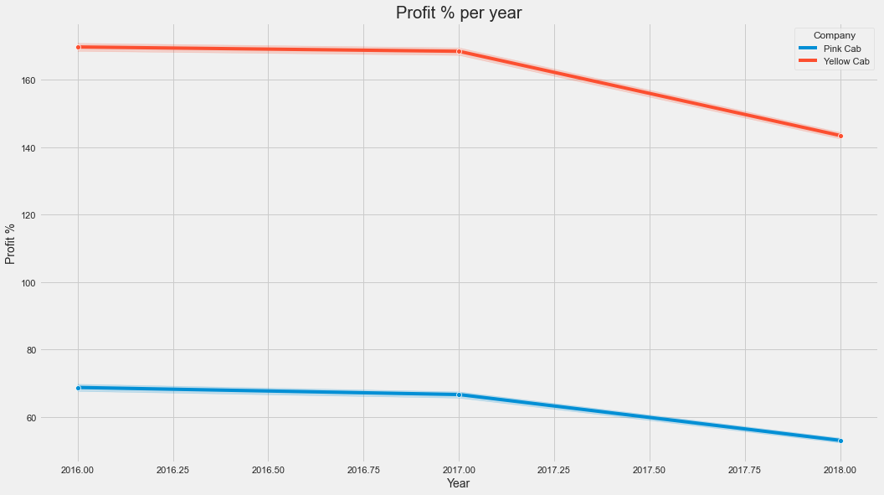
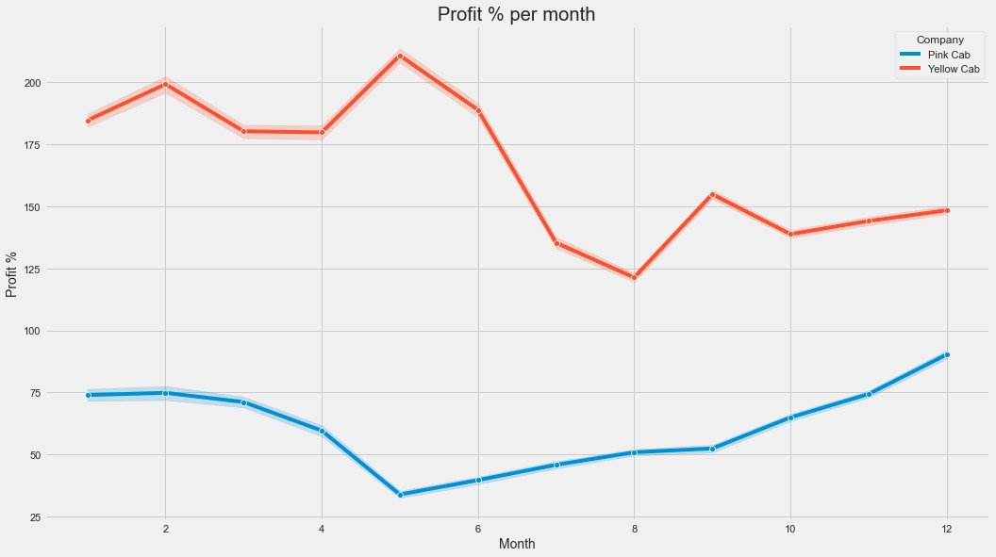
Profit Margin based on Time
The profit margin decreased by the year
The profit margin varies based on per month

Slide 21
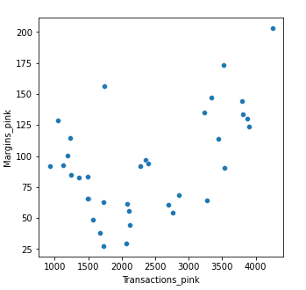
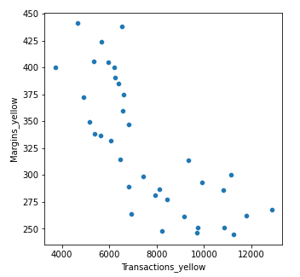
Margins per Transactions
The pink cab’s margins increased when there was an increase in transactions
The yellow cab’s margins decreased when there was an increase in transactions

Slide 22
Hypothesis Testing

Slide 23
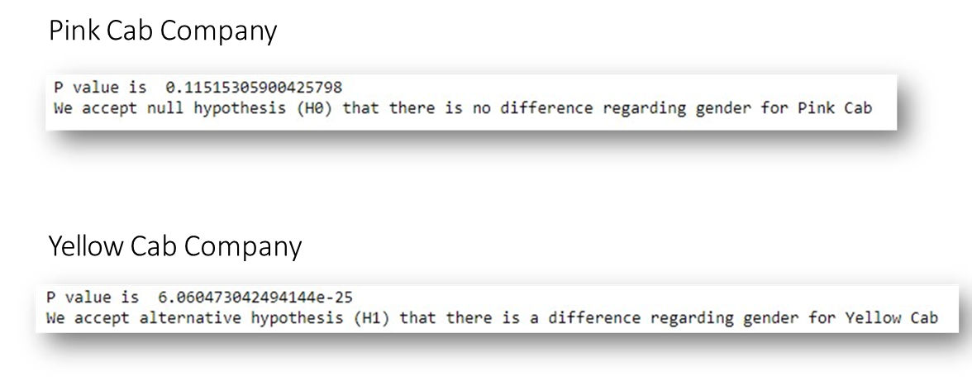
Hypothesis 1: Is there any difference in profit regarding gender?
H0: There is no difference regarding gender in both cab companies
H1: There is a difference regarding gender in both cab companies
Conclusion: There is no difference regarding gender among both cab companies.

Slide 24
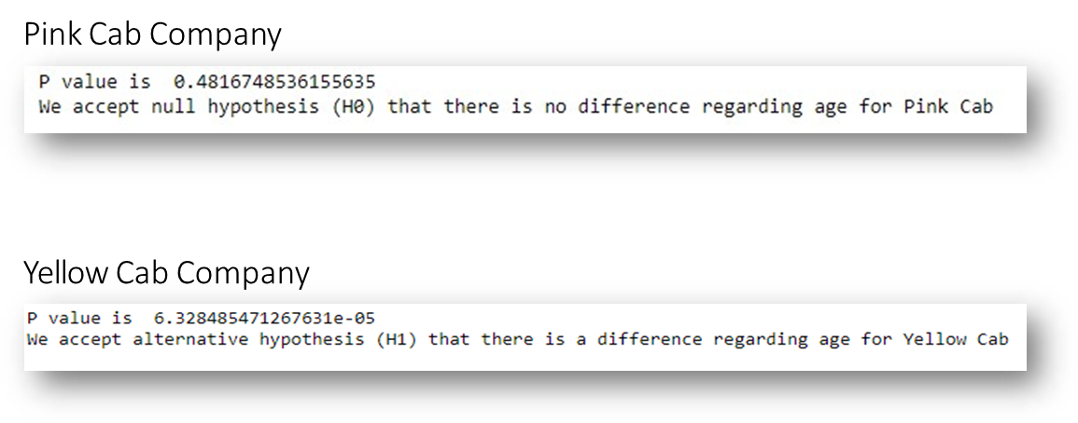
Hypothesis 2: Is there any difference in profit regarding age?
H0: There is no difference regarding age in both cab companies.
H1: There is a difference in age in both cab companies.
Conclusion: The yellow cab offered discounts for customers older than 60 years old.

Slide 25
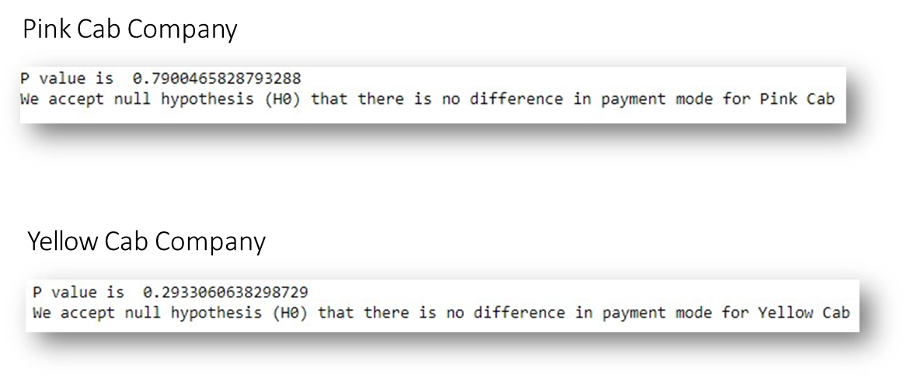
Hypothesis 3: Is there any difference in profit regarding payment mode?
H0: There is no difference regarding payment mode in both cab companies.
H1: There is a difference regarding payment mode in both cab companies.
Conclusion: There is no difference in payment mode for both cab companies.

Slide 26
Recommendations
The year-end transaction per year from 2016 to 2018 for the yellow cab is almost double that of the pink cab.
The profit margin is higher per year from 2016 to 2018 for the yellow cab than for the pink cab.
The yellow cab is recommended for investment.

Slide 27
Thank You

